Slide 1
Content Understanding

Slide 2
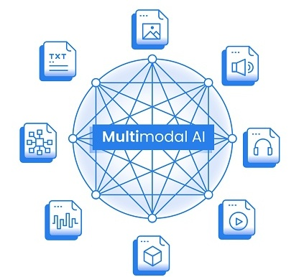

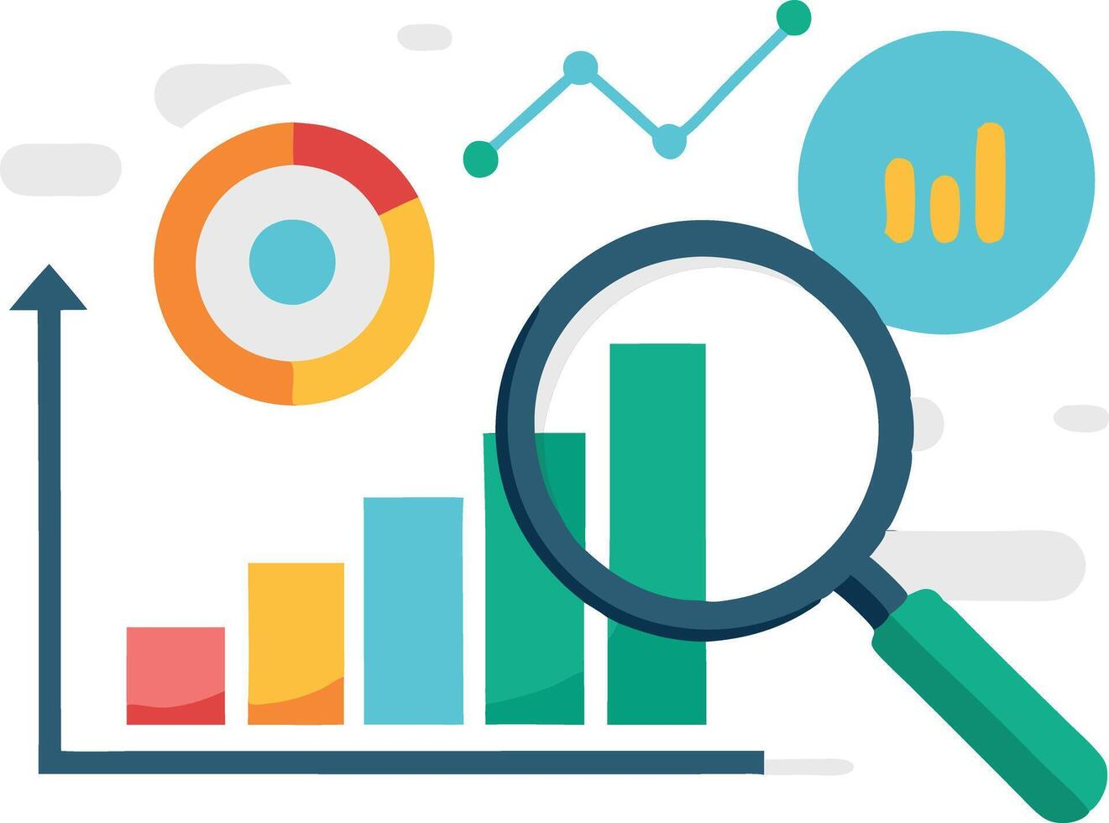
Organizational challenges
Multimodal Data
ability to process and integrate data from multiple modalities such as text, images, videos, and audio
Unstructured Data
requires advanced analysis to extract meaningful information
Comprehensive Analysis
to gain a holistic view across different channels
Diverse Data Types and Sources
Comprehensive solution for handling diverse data types and converting them into structured, actionable insights
Leverages AI to unlock insights from various data formats, making it especially suitable for complex scenarios where data is not neatly organized
Content Understanding provides the tools to analyze and integrate insights from all available data sources

Slide 3





Azure AI Content Understanding
Unlock insights, enhance capabilities, improve efficiencies by leveraging unstructured data across diverse modalities
Build Comprehensive Agentic Solutions
Feeds your Rag Solutions
Powers Analytics and Insights

Slide 4








Announcing a new Pro mode with reasoning
Inputs
Analyzers
Output
Search
Content Extraction
Field Extraction
Documents
New
Agents
Preprocessing
Enrichments
Gen AI
Postprocessing
Reasoning
Image
Normalization (resolution, formats)
Orientation / de-skew
Speaker recognition
Layout and structure
Face grouping
Context windows
Prompt tuning
Confidence scores
Grounding
Normalization
Multi-file input
Reference data
Databases
Video
Structured
output
Markdown or JSON schema
Copilots
Audio
Apps
Replaces multiple extraction calls followed by a human validation process with one simple operation
Enable richer, more complex and adaptable task within agentic workflows
Fabric
Notes:
Double clicking a little bit more on the content understanding capabilities and also how the processing inside of the service works.
As I already mentioned we have different data types you can process, such as documents, images, videos, audio text
First step is Content Extraction
Purpose: Convert unstructured or semi-structured inputs into a structured format that Large Language Models (LLMs) or generative AI can understand.
Examples: For example in this step we transcribe audio files, this is where OCR and the normalization for documents
We have add-On Capabilities (Enrichments)for example
Speaker Role Detection (e.g., identifying “agent” vs. “customer” in audio)
Layout and Structural Enrichments (e.g., detecting sections or tables in documents)
Face Grouping (in images or video)
Enhanced content that can be used directly or passed to further processing.
Then comes Field Extraction (Generative AI Stage)
Purpose: Extract and classify structured data using generative AI.
Examples:
Invoices → Capture fields like invoice number, date, and total amount in a structured format
Call Summaries → Generate summary of conversation, including sentiment analysis
This is where the Schema is applied: Define the specific data fields or categories relevant to your business use case.
And then Post-Processing
Confidence Scoring: Assign reliability scores to extracted data.
Grounding & Normalization: Ensure outputs align with factual and consistent data formats (e.g., standardizing date formats, currency codes, etc.). to give you structured results
Final Structured Output: Results are packaged for easy consumption by downstream applications. Such as
Integration with BI tools or dashboards
Copilot-style applications for end-users
Database storage or Fabric integration
Agent-based automation
Value: Quickly build solutions on top of clean, structured data without reinventing the wheel.

Slide 5



Benefits of Content Understanding
Multimodal Data Ingestion
Information Extraction Schema
Grounding and Confidence Scores
Improve data quality and accuracy
Ingest a range of modalities, including documents, images, audio, or video
Use a range of Azure AI models to convert input data into a structured format
Process and analyze through downstream services or applications
Define schemas of extracted results
Generate task-specific representations of the output, including insights, features, or summaries
Build enterprise GenAI apps or agentic workflows to automate business processes through LLMs and RAG
Ensure schema-identified values are accurate and usable with GenAI tools
Ground extracted information in underlying content
Provide confidence scores to reduce human intervention
Enable continuous improvement through user feedback
Streamline workflows and reduce costs
Customize output for any data type
Content Understanding - Azure AI Foundry

Slide 6




Capabilities at a Glance
Documents
Image
Audio
Video
OCR of printed or handwritten text
Layout information
Barcodes / Formulas
Cross page tables
Selection Marks
Extract, Generate and classify field values
Content Classification
Generate titles, descriptions, and summaries
Classify elements
Transcription
Multi-lingual Transcription
Diarization and language detection
Identify speaker roles
Generate conversation summaries and topics
Determine sentiment
Transcription
Shot detection
Key frame extraction
Face Grouping (gated)
Face Detection (gated)
Generate summaries
Determine sentiment

Slide 7




Industry Scenarios
Enterprise
Consumer Insights & Retail
Government & Legal
Media & Entertainment
Contract Intelligence: Extract clauses, obligations, and risks from legal documents and generate compliance checklists.
Invoice and purchasing: Automate the extraction of key details from invoices and purchase orders, streamline approval workflows, and ensure compliance with financial regulations.
Supply Chain Optimization: automating document-centric steps and providing real-time decision support across a web of information – orders, inventories, routes, and external factors like weather or port conditions.
Customer Feedback Analysis: Aggregate and analyze reviews, customer calls, and social media posts to generate product improvement insights.
Visual Merchandising Optimization: Analyze in-store images and videos to assess shelf placement, branding, and customer behavior.
Voice of the Customer: Combine call center transcripts, emails, and survey data to generate customer satisfaction reports.
E-Discovery Analysis: Modern litigation and investigations must process multimedia evidence (e.g. police reports, witness audio, video evidence)
Administrative Process Automation (digitizing forms and records): Automate information extraction from diverse forms and records, speeding up processes and improving efficiency.
Regulatory Compliance: Analyze multimodal data for compliance violations and generate audit-ready reports.
Media Asset Management and Content Indexing: Studios, broadcasters, and content creators often need to organize and search through vast libraries of media. Tag and index audio-visual content to make it easily searchable.
Automated Highlights and Content Generation: for long videos, such as sports games, AI can identify key moments, extract those segments and stitch them together to generate a draft highlight reel.
Agentic Solutions
RAG Solutions
Power Insights

Slide 8




Industry Scenarios
Health Care
Marketing & Advertising
Banking & Finance
Energy & Utilities
Clinical Documentation Analysis: Extract patient data from handwritten notes, scanned forms, and audio dictations; generate structured summaries.
Medical Imaging Insights: Combine radiology images with patient records to generate diagnostic hypotheses or treatment suggestions.
Pharmacovigilance: Monitor and summarize adverse event reports from text, audio calls, and scanned documents.
Personalized Content Generation and Dynamic Experiences: agencies can feed in a brand’s existing content (web pages, PDF brochures, product images, videos, audio testimonials, etc.) and then create new, tailored user experiences.
Advertising Analytics and Asset Optimization: analyze ads and customer interactions to inform better marketing decisions, extracting successful elements from past campaigns to enhance future engagement and streamline asset organization.
Fraud Detection and Risk Management: Multimodal AI improves fraud detection by integrating and identifying unusual patterns across diverse data sources, providing a holistic view for faster, more accurate fraud alerts and risk assessments,
Document Processing and Compliance Automation: extract key information across many different document types regardless of format (loan applications, tax forms, insurance claims, regulatory filings, etc.)
Integrated Asset Management and Resource Optimization: unify diverse data streams for holistic decision-making, optimizing operations and safety in energy and utilities sectors by integrating sensor, image, and text data.
Predictive Maintenance and Grid Reliability: enhances predictive maintenance by analyzing visual and sensor data, quickly identifying infrastructure risks to prevent outages and optimize grid reliability.
Agentic Solutions
RAG Solutions
Power Insights

Slide 9
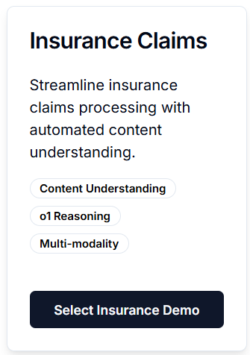
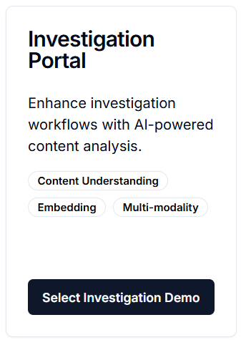
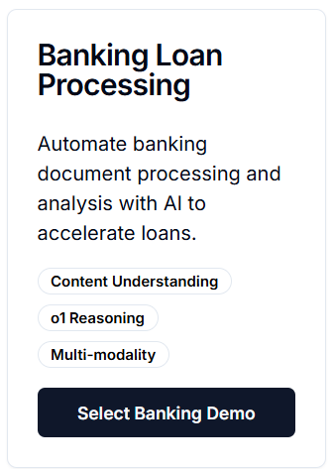
Content Understanding Demos
Vimeo Live Demo
Vimeo Live Demo
Vimeo Live Demo
Demo Landing Page: Azure AI in Action

Slide 10


Reasoning on multimodal content for efficient agentic AI app building
Wednesday, May 21 | 2:00 PM - 3:00 PM Pacific Daylight Time
Duration 1 hour
Arch, 705 Pike, Level 6, Room 608 BRK169
Speakers:
Azure AI Content Understanding is designed for developers to streamline content processing tasks. It automates complex workflows and reduces manual intervention by delivering structured and reliable data tailored to specific goals. With advanced reasoning capabilities, it can now optimize processing performance, enabling efficient AI app creation and saving time, allowing developers to focus on building agentic AI apps quickly and effectively.

Slide 11







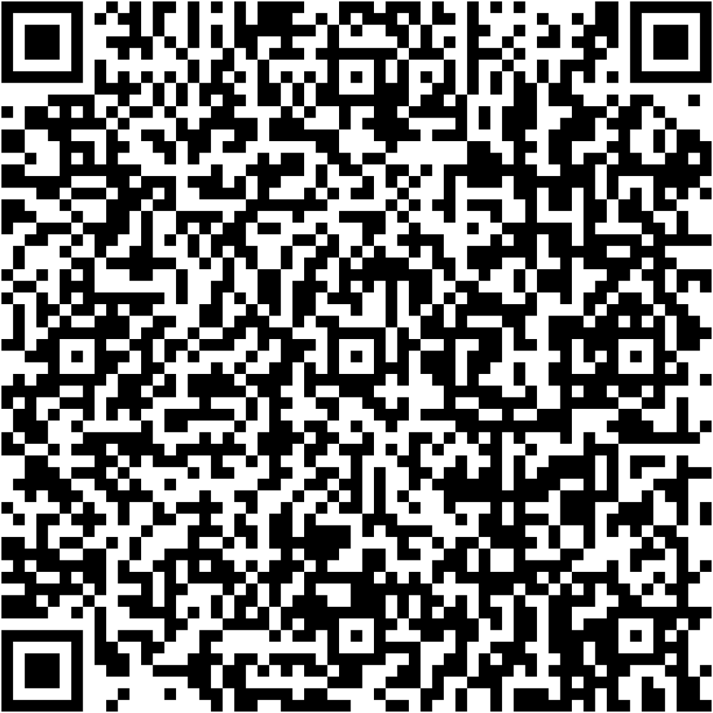
Content Understanding:
Try it in Azure AI Foundry:
Samples repository:
https://aka.ms/cu-landing
https://aka.ms/cu-samples
Documentation:
Pricing:
https://aka.ms/cu-docs
https://aka.ms/cu-pricing
Contacts:
Connect with the CU team
Connect with the DI team
https://aka.ms/cu-contact
https://aka.ms/di-contact
Solution Templates:
Conversation Knowledge Mining AI Solution:
Azure Multimodal AI + LLM Processing
https://aka.ms/Conversational-Knowledge-Mining
Multimodal-ai-llm-processing

